Slide 1

DESIGN AND ANALYSIS OF ALGORITHMS (113939)
Dr. Owais Hussain

Slide 2

Agenda
Backtracking Desing Strategy
A Simple Example
Sudoku
Exercise
Magic Square
Recap: Trees
Depth First Search
N-Queen Problem

Slide 3
Sample 2
Backtracking Design Strategy
Backtracking is a Brute-force design strategy with an Undo option.
Backtracking explores all possible options, but if an option seems to be leading to a dead-end (non-promising), it goes back to previous stage and explores the next option.
It is mainly used to solve search problems and puzzles.

Slide 4
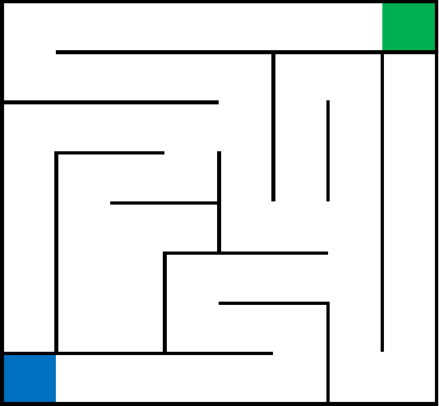
Sample 2
A Simple Example
You are at the blue block in KIET’s main campus, and the green block is where your exam is being conducted. You do now know where your room is, and nobody is around to tell you.
How will you reach your destination?

Slide 5
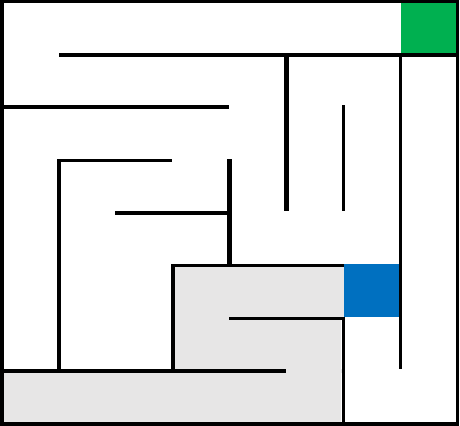
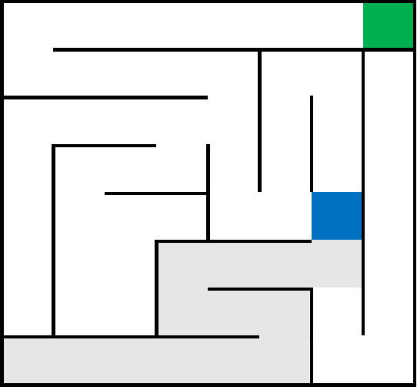
Sample 2
A Simple Example
You walked until you reached a corridor where you need to decide whether to go right or left. You randomly choose to go left.

Slide 6
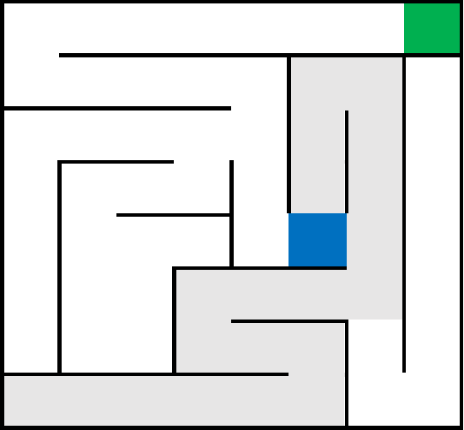
Sample 2
A Simple Example
Once again, you need to decide whether to turn left or take the right way. You randomly chose the right path.

Slide 7
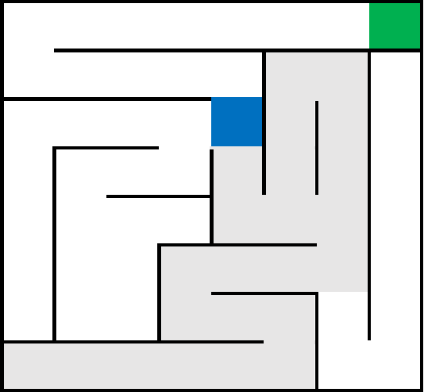
Sample 2
A Simple Example
Again, you have a choice to go left or right, but left path has already been explored, so you go right.

Slide 8
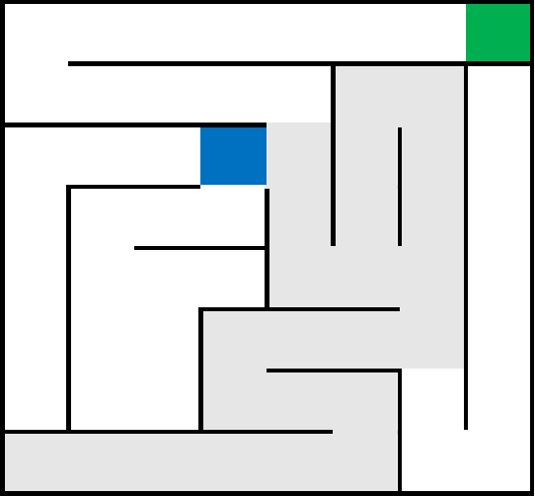
Sample 2
A Simple Example
Once again, you need to decide which way. You randomly chose to go left. And then another left.

Slide 9
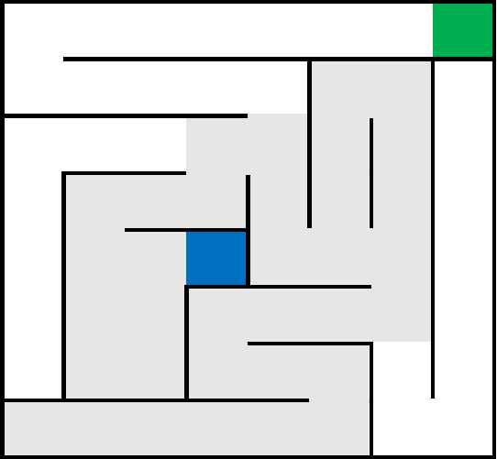
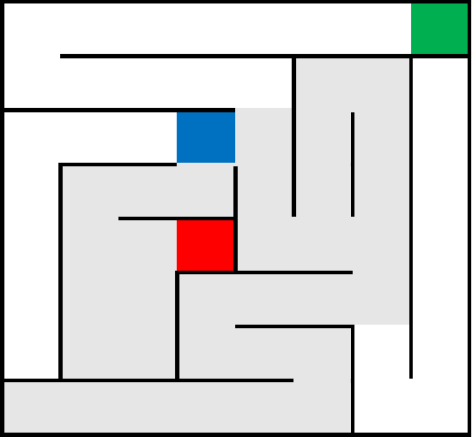
Sample 2
A Simple Example
At this point, you reach a dead-end. Therefore, you backtrack to last decision place. You DO NOT start from the beginning.

Slide 10
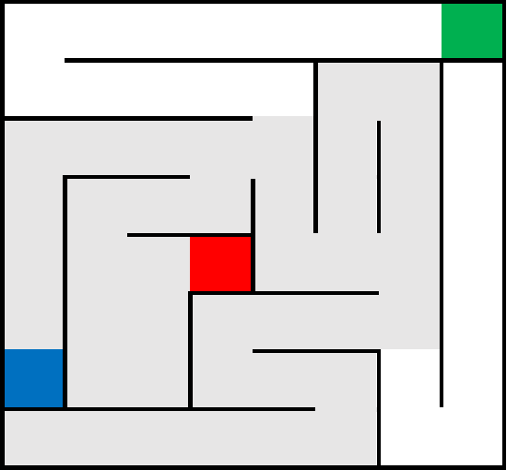
Sample 2
A Simple Example
Now that you’re back at previous checkpoint, do you have two paths to take or one?
You only have one way because the other one has already been visited.

Slide 11
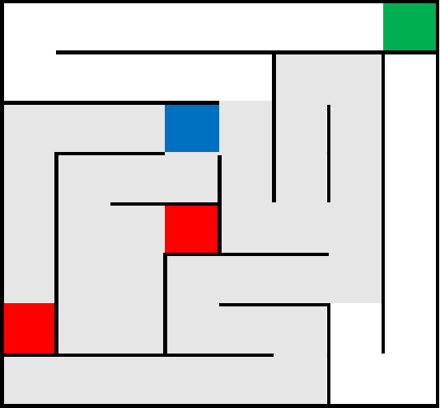
Sample 2
A Simple Example
The problem is that this path also leads to a dead-end. Therefore, you backtrack to previous checkpoint.

Slide 12
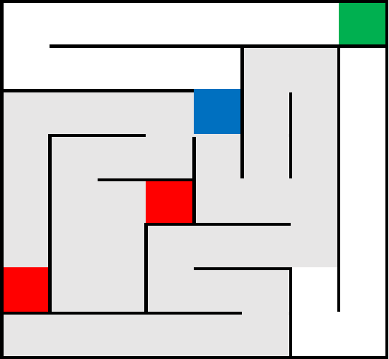
Sample 2
A Simple Example
You have already visited both paths; you backtrack once more to the checkpoint before the current one.

Slide 13
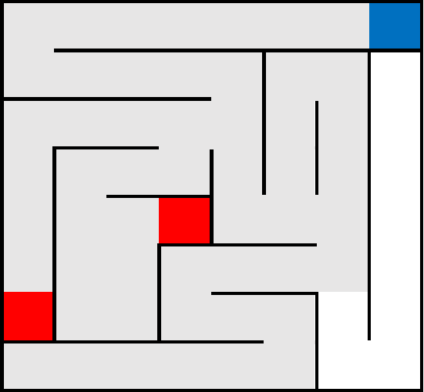
Sample 2
A Simple Example
Only one way to go now, which takes you to your examination room.

Slide 14
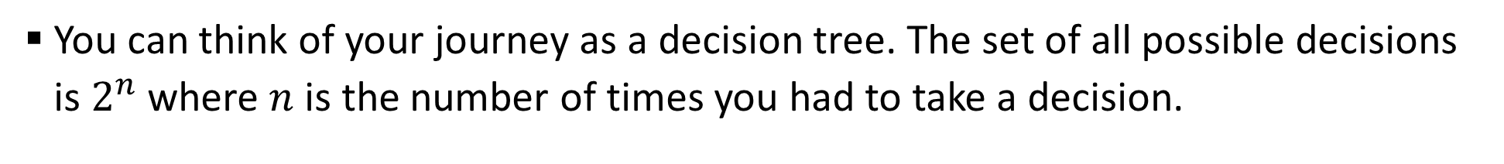
Sample 2
A Simple Example
You can think of your journey as a decision tree. The set of all possible decisions is $2^{n}$ where $n$ is the number of times you had to take a decision.
Start
R
L
R
L
R
L
R
R
L
L
R
L
R
L
R
L
R
L
R
L
R
L
R
L
R
L
R
L
R
L
R
L
R
L
R
L
R
L
R
L
R
L
R
L
R
L
R
L
R
L
R
L
R
L
R
L
R
L
R
L
R
L

Slide 15
Sample 2
A Simple Example
However, your backtracking approach eliminated non-promising routes entirely. Leaving only a fraction of promising paths to explore.
Start
L
R
L
R
L
R
L
R
L
R
L
R
L
R
L
R
L
R

Slide 16
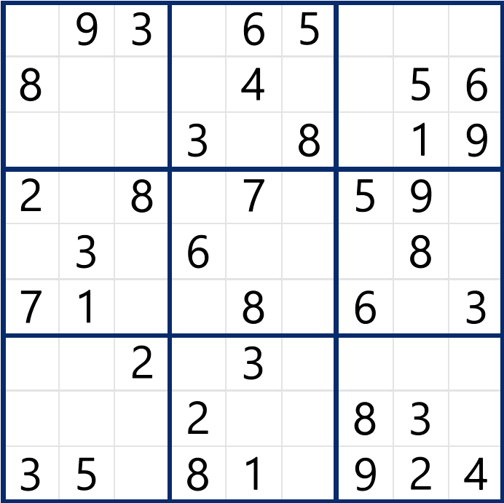
Sample 2
Exercise
Solve the given Sudoku. The rules are simple:
Each box should contain all numbers from 1-9.
No two numbers can be placed in the same row or column of the whole puzzle.
Each row and column should also contain all numbers from 1-9.

Slide 17
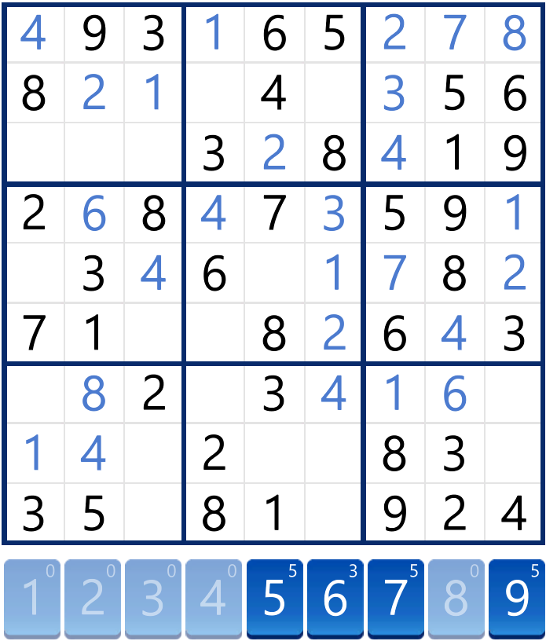
Sample 2
A semi-solved Sudoku.
Can you place the remaining tiles?
Note that no two numbers lie in the same row/column.
Also note the two solved boxes and the two complete columns.

Slide 18
Sample 2
Sudoku
If you have successfully solved the Sudoku puzzle, then you mind is already using a Backtracking strategy.
Observe that as you decide whether a number fits in a specific cell or not, you do not go back all the way, but rather resume from a safe checkpoint.

Slide 19
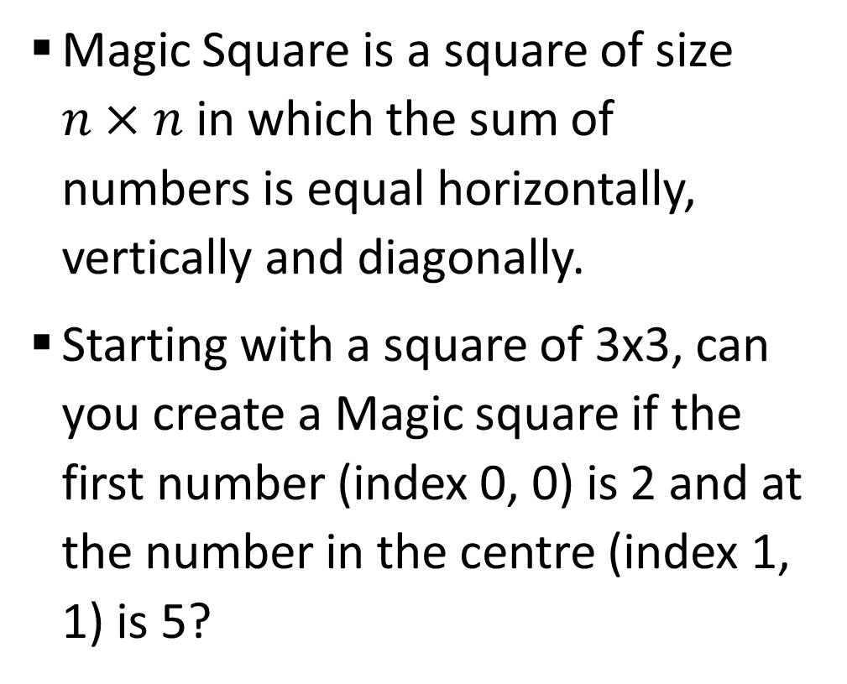
Sample 2
Magic Square
Magic Square is a square of size $n×n$ in which the sum of numbers is equal horizontally, vertically and diagonally.
Starting with a square of 3x3, can you create a Magic square if the first number (index 0, 0) is 2 and at the number in the centre (index 1, 1) is 5?
2 | 7 | 6
9 | 5 | 1
4 | 3 | 8

Slide 20
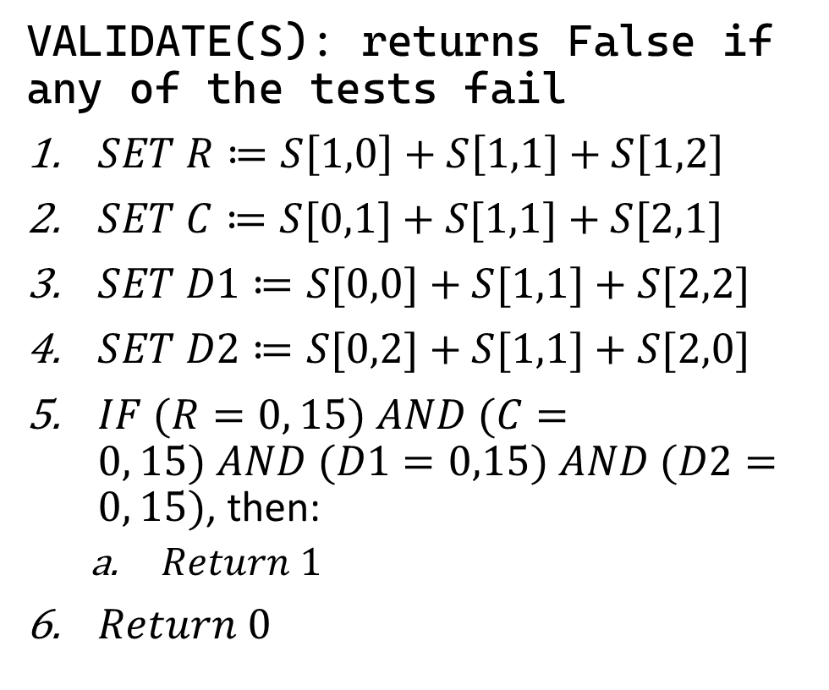
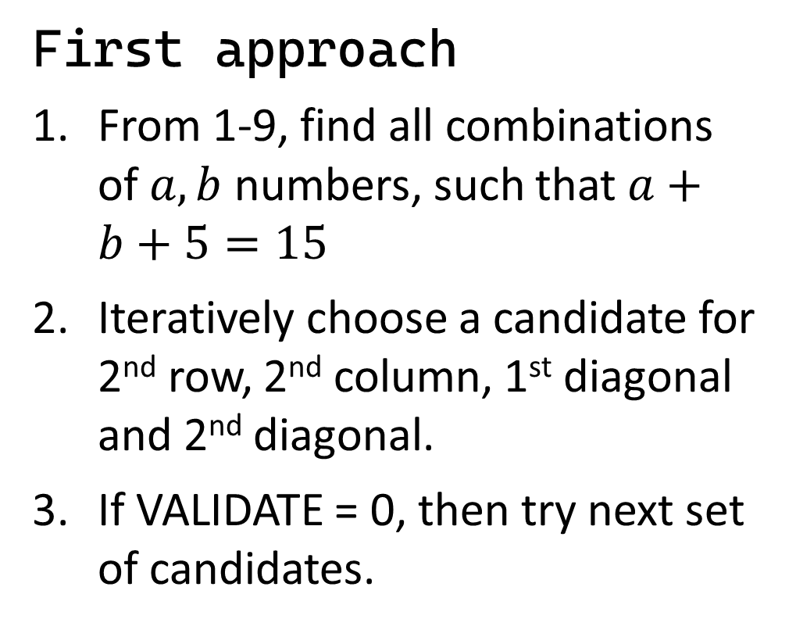
Sample 2
Magic Square
VALIDATE(S): returns False if any of the tests fail
$SET R≔S\left[1,0\right]+S\left[1,1\right]+S\left[1,2\right]$
$SET C≔S[0,1]+S[1,1]+S[2,1]$
$SET D1≔S[0,0]+S[1,1]+S[2,2]$
$SET D2≔S[0,2]+S[1,1]+S[2,0]$
$IF (R=0, 15) AND (C=0, 15) AND (D1=0,15) AND (D2=0, 15)$, then:
$Return 1$
$Return 0$
First approach
From 1-9, find all combinations of $a,b$ numbers, such that $a+b+5=15$
Iteratively choose a candidate for 2nd row, 2nd column, 1st diagonal and 2nd diagonal.
If VALIDATE = 0, then try next set of candidates.

Slide 21
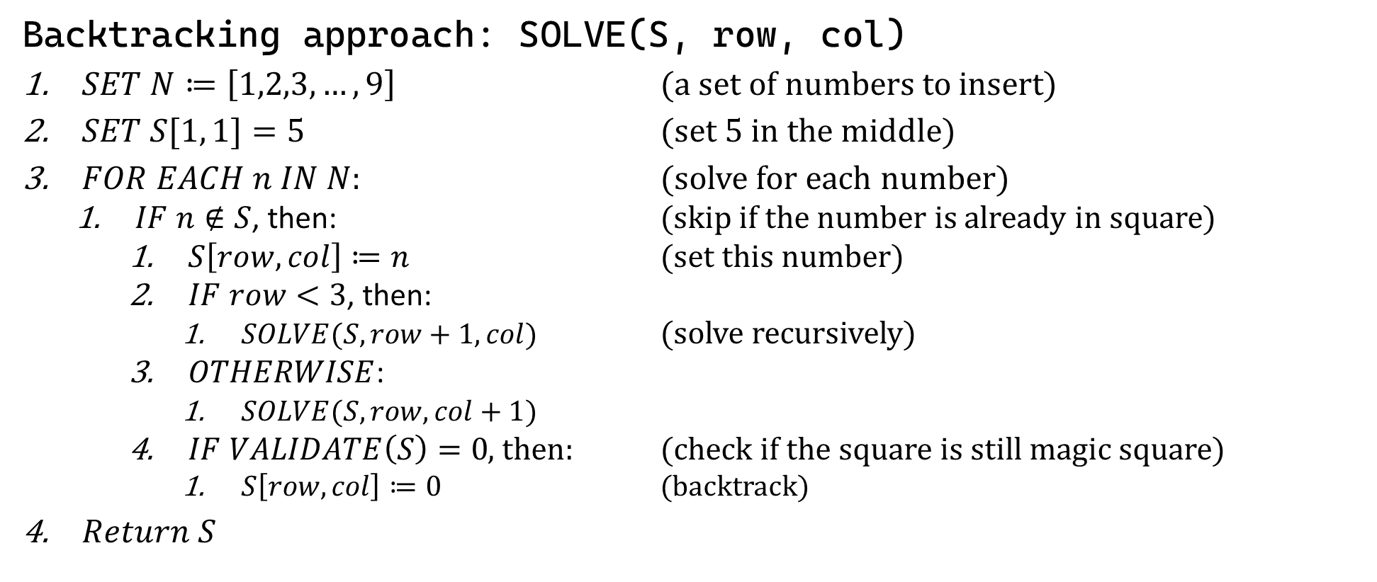
Sample 2
Magic Square
Backtracking approach: SOLVE(S, row, col)
$SET N≔\left[1,2,3,…,9\right]$ (a set of numbers to insert)
$SET S[1, 1]=5$ (set 5 in the middle)
$FOR EACH n IN N:$ (solve for each number)
$IF n∉S$, then: (skip if the number is already in square)
$S\left[row,col\right]≔n$ (set this number)
$IF row<3$, then:
$SOLVE(S, row+1, col)$ (solve recursively)
$OTHERWISE$:
$SOLVE(S,row,col+1)$
$IF VALIDATE\left(S\right)=0$, then: (check if the square is still magic square)
$S\left[row,col\right]≔0$ (backtrack)
$Return S$

Slide 22
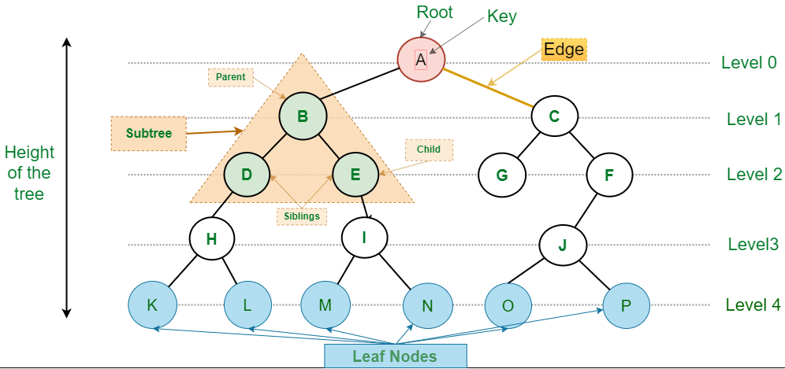
Sample 2
Trees
Notes:
Attribution: GeekForGeeks.com

Slide 23
Sample 2
Binary Trees
Full
1
2
1.1
1.2
2.2
1.1.2
1.1.1
2.2.2
2.2.1
2.1.2
2.1.1
2.1
Complete
1
2
1.1
1.2
2.1
2.2
1.1.1
1.1.2
1.2.1
1.2.2
2.1.1
Perfect
1
2
1.1
1.2
2.1
2.2
1.1.1
1.1.2
1.2.1
1.2.2
2.1.1
2.1.2
2.2.1
2.2.2

Slide 24
Sample 2
Binary Trees
Full and Complete
1
2
1.1
1.2
2.1
2.2
1.1.1
1.1.2
1.2.1
1.2.2
Complete, Not Full
1
2
1.1
1.2
2.1
1.1.1
1.1.2
1.2.1
1.2.2
2.2
2.1.1
Full, Not complete
1
2
1.1
1.2
1.1.2
1.1.1
Not Full, Not Complete
Can you make one?

Slide 25
Sample 2
Depth First Search
In-order: First, the left child is visited, then parent, and then right child. This is used to traverse the tree in the same order as the nodes where inserted.
Pre-order: First, the parent is visited, then left child, then right child. This is mainly used to create a copy of tree.
Post-order: First, the left child is visited, then right child, then parent. This is mainly used to destroy/clear a tree.
5019
4669
4930
4901
5040
4910
5144
Search | Order of Visiting Nodes if target is 5144
DFS | 5019, 4669, 4930, 4901, 5040, 4910, 5144
BFS | 5019, 4669, 5040, 4930, 4901, 4910, 5144
Notes:
Recall that the difference between Traversing and Search is that Search halts whenever the target element is found.

Slide 26
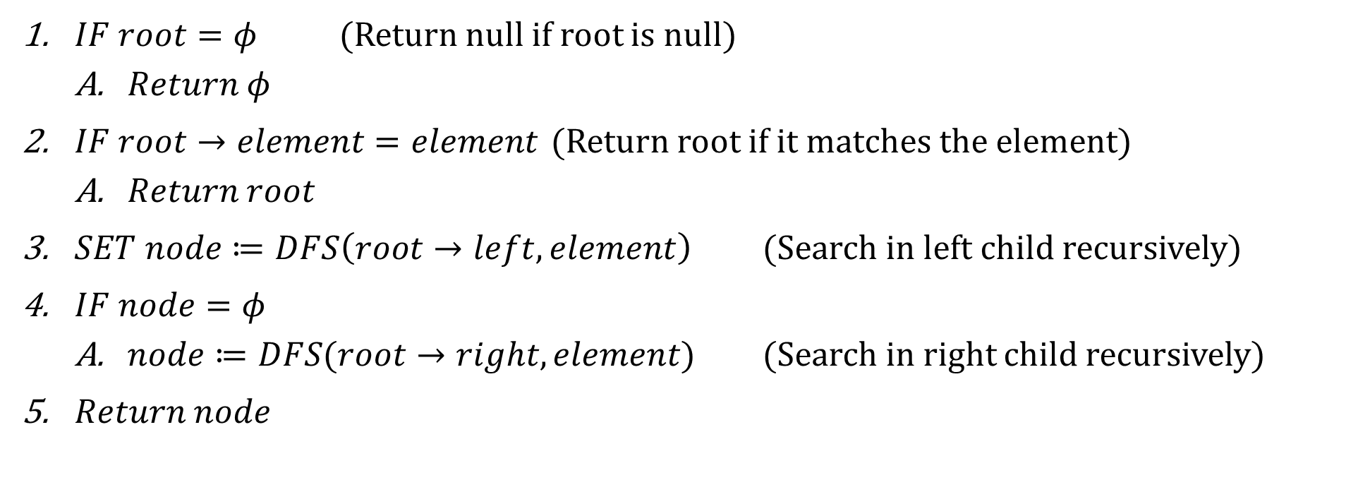
Sample 2
Depth First Search
DFS(root, element), Searches for the node which matches the ‘element’; ‘root’ is the pointer to root node of Tree.
$IF root=φ$ (Return null if root is null)
$Return φ$
$IF root→element=element$ (Return root if it matches the element)
$Return root$
$SET node≔DFS\left(root→left, element\right)$ (Search in left child recursively)
$IF node=φ$
$node≔DFS(root→right, element)$ (Search in right child recursively)
$Return node$

Slide 27
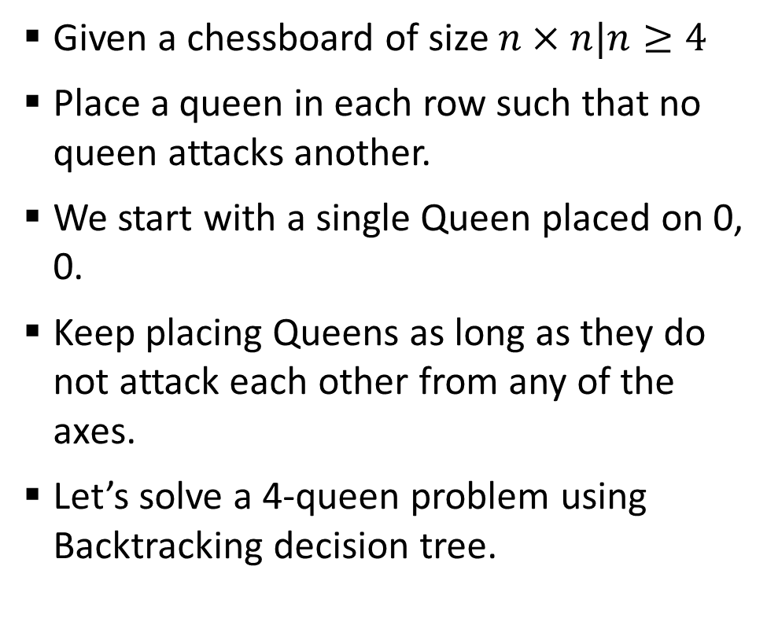
Sample 2
N-Queen Problem
Given a chessboard of size $n×n|n≥4$
Place a queen in each row such that no queen attacks another.
We start with a single Queen placed on 0, 0.
Keep placing Queens as long as they do not attack each other from any of the axes.
Let’s solve a 4-queen problem using Backtracking decision tree.
♕

Slide 28
Sample 2
N-Queen Problem
Denoting queens as $a,b,c,d$. The position in string represents column and the level of tree represents row in which a queen lies.
a---
ab--
Root
a-b-
abc-
ab-c
acb-
a-bc
abcd
abdc
acbd
adbc
Adcb
acdb
ac-b
a-cb
a--b
-a--
--a-…
---a
…
…
…

Slide 29
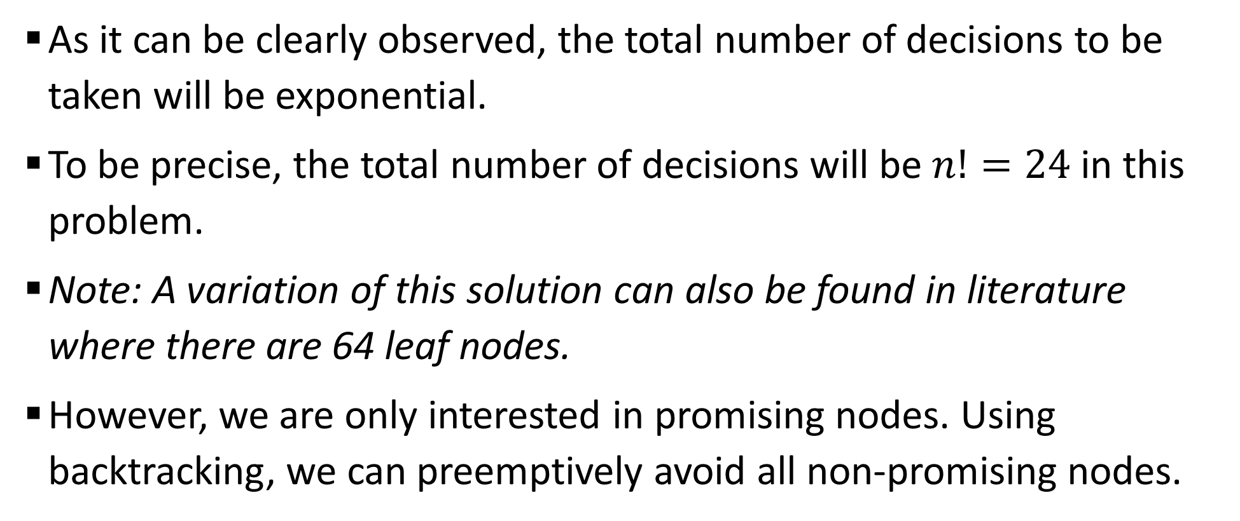
Sample 2
N-Queen Problem
As it can be clearly observed, the total number of decisions to be taken will be exponential.
To be precise, the total number of decisions will be $n!=24$ in this problem.
Note: A variation of this solution can also be found in literature where there are 64 leaf nodes.
However, we are only interested in promising nodes. Using backtracking, we can preemptively avoid all non-promising nodes.

Slide 30
Sample 2
N-Queen Problem
Non-promising nodes are never visited (Red). Algorithm backtracks from where Queens are attacking each other (Orange).
a---
ab--
Root
a-b-
abc-
ab-c
acb-
a-bc
abcd
abdc
acbd
adbc
adcb
acdb
ac-b
a-cb
a--b
-a--
--a-…
---a
…
…
…
♕
 |  |  | ♕
 | ♕
? | ? | ? | ?

Slide 31
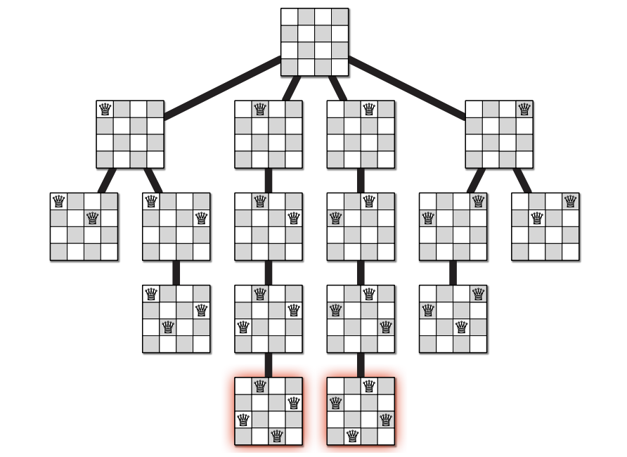
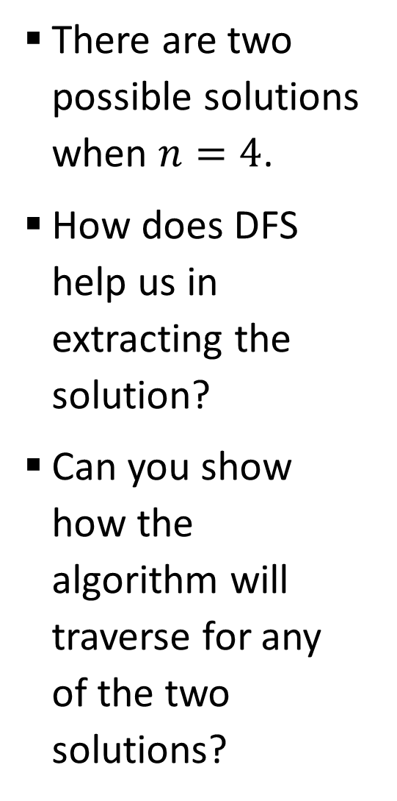
Sample 2
Depth First Search
There are two possible solutions when $n=4$.
How does DFS help us in extracting the solution?
Can you show how the algorithm will traverse for any of the two solutions?

Slide 32
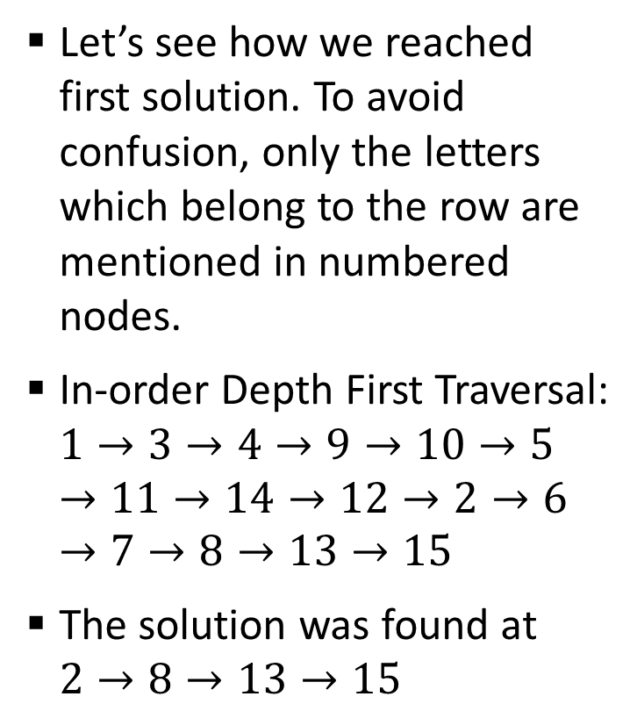
Sample 2
N-Queen Problem
Let’s see how we reached first solution. To avoid confusion, only the letters which belong to the row are mentioned in numbered nodes.
In-order Depth First Traversal: $1→3→4→9→10→5→11→14→12→2→6→7→8→13→15$
The solution was found at $2→8→13→15$
1|a---
3|-b--
Root
9|-c--
10|---c
14|--d-
11|-c--
12|a-cb
5|---b
2|-a--
6|b---
7|--b-
8|---b
13|c---
4|--b-
15|--d-

Slide 33
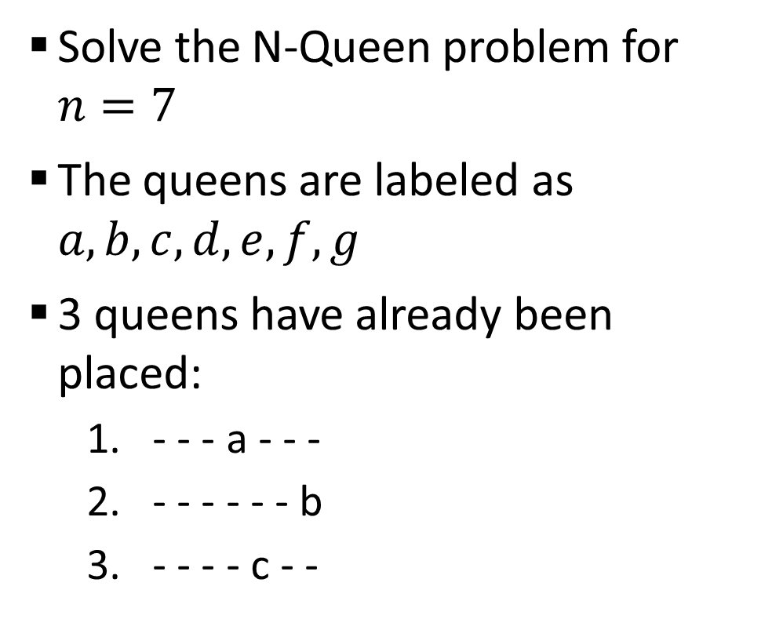
Sample 2
DIY
Solve the N-Queen problem for $n=7$
The queens are labeled as $a,b,c,d,e,f,g$
3 queens have already been placed:
- - - a - - -
- - - - - - b
- - - - c - -
 |  |  | ♕
 |  |  |  |  |  | ♕
 |  |  |  | ♕

Slide 34



THANK YOU
Owais Hussain
+92 345-3174270
owais.hussain@kiet.edu.pk
https://www.researchgate.net/profile/Owais-Hussain-3

